Slide 1
Progressive Combinatorial Algorithm for Multiple Structural Alignments:Application to Distantly Related Proteins
Maria Elena Ochagavia and Shoshana Wodak
PROTEINS:Structure,Function and Bioinformatics, Vol. 55, pp. 436-454, 2004
Reporter: Chia-Chang Wang
Date: Nov. 12, 2004

Slide 2
Introduction
MALECON
It uses a library of pairwise alignments and proceeds by a combinational approach.
The key issue is maximizing the consistency between the pairwise and multiple alignments.

Slide 3
Methods-Constructing the Library of Pairwise Superpositions
SoFist
input:
The atomic coordinate of the two proteins
Similarity is Evaluated by RMSD

Slide 4
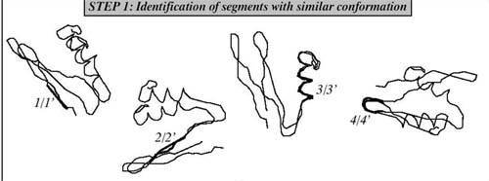
SoFist(1)
Identifying polypeptide segments with similar backbone conformations in both 3D structures

Slide 5
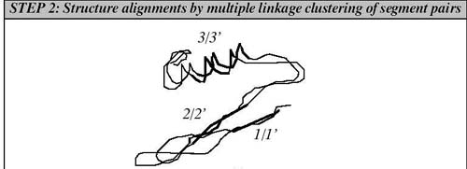
SoFist(2)

Slide 6
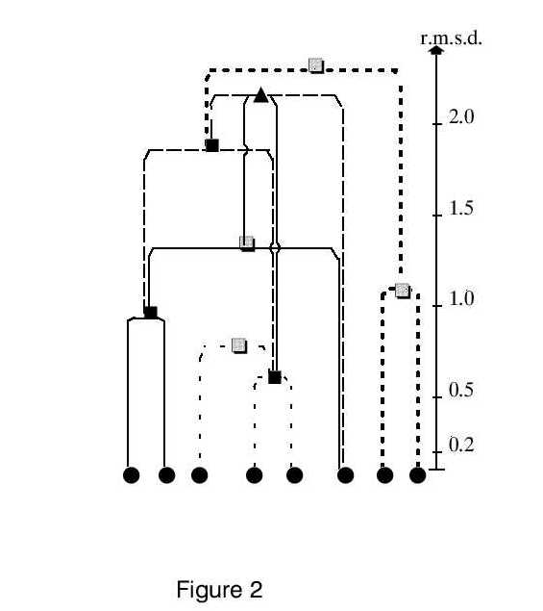
Notes:
Figure 2. Schematic representation of a multiple linkage clustering (MLC) tree, used in the structure alignment procedure.
Pairs of overlapping 5-residue segments with similar backbone conformations (black circles) are the initial classes at the bottom of the trees. Joined classes are represented by boxes or triangles. Grey boxes represent classes that are combined at most once, and thus correspond to nodes in a single linkage tree-like classification. Black boxes represent classes that are combined more than once. Triangles represent nodes that are reached by more than one pathway from the bottom of the trees. Solid lines and the different types of dashed lines correspond to the different intertwined trees. The r.m.s.d. of the classes are given on the right hand side of the Figure. For sake of simplicity, all 5-residue segment pairs (black circles) appear at the same r.m.s.d.level, even though they clearly do not display equal r.m.s.d.'s.

Slide 7
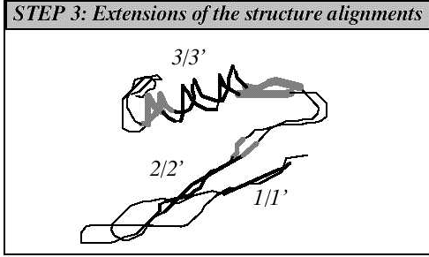
SoFist(3)

Slide 8
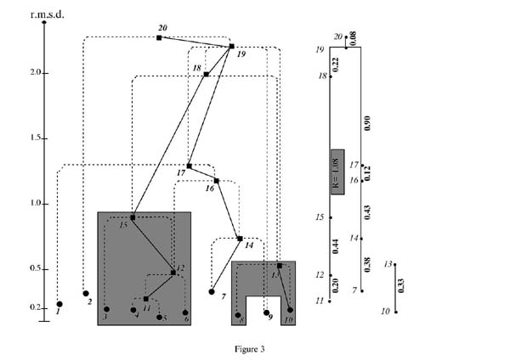
Notes:
Figure 3. Illustration of the procedure for identifying rigid-body movements from a multiple linkage clustering (MLC) tree.
The initial 5-residue segment pairs, numbered from 1 to 10, are represented by black circles and the combined classes, numbered from 11 to 20, by black boxes. The intertwined trees connecting the classes are represented by dashed lines. Each class is linked by a solid line to the one of its 2 subclasses, which displays the smallest difference in r.m.s.d. The r.m.s.d. values (in Å) are given to the left of the tree and the r.m.s.d. differences in Å (in bold) between classes (in italic) are indicated to the right. The 2 grey areas group the classes corresponding to the 2 structural domains that display the largest rigid-body movement relative to one another; combining them leads to an r.m.s.d. jump (R-value) of 1.08 Å

Slide 9
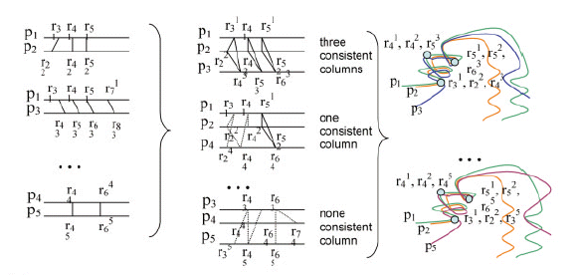
Methods-Constructing three-protein superpositions

Slide 10
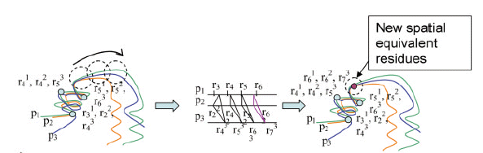
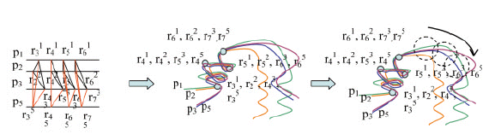
Methods-Extending the Alignment to n-protein

Slide 11
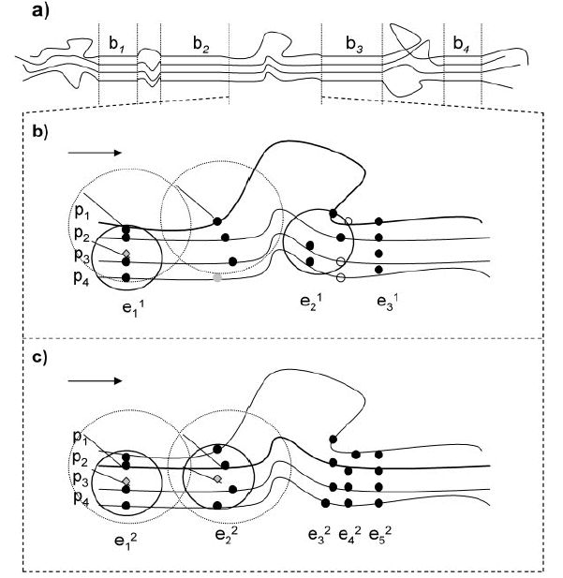

2R

Slide 12
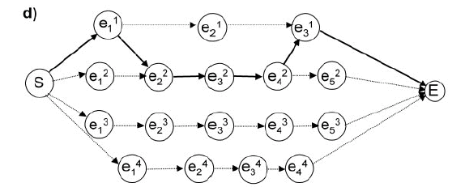
A
B

Slide 13
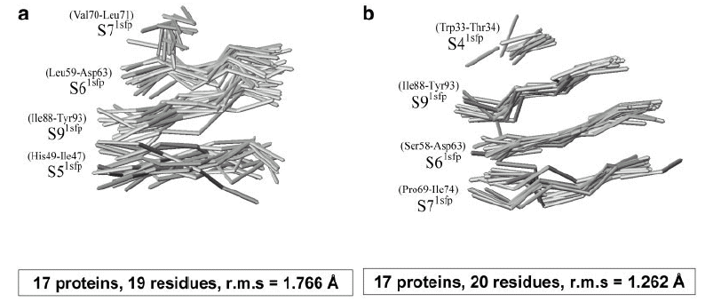
Results

Slide 14
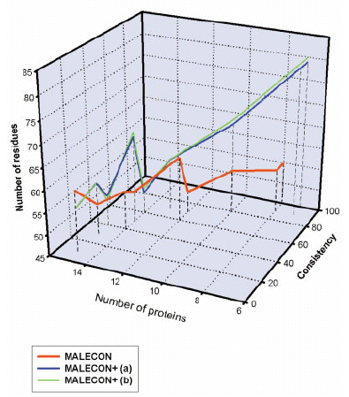
Results(cont.)
Trade-off between the number if aligned residues and proteins and alignment consistency

Slide 15
Conclusion
When no consistent multiple alignments can be derived for all members of a protein group,this method is useful.
To perform a meaningful selection, those might in turn depend on the subsequent use that one wants to make of the multiple alignments.

Slide 16
Thanks for your attention.

